Slide 1
Nashville City Cemetery

Slide 2
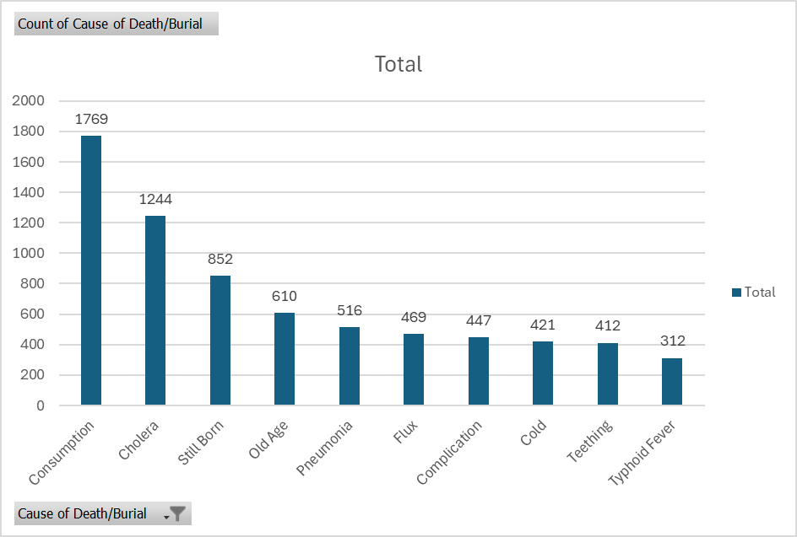
Notes:
Consumption
Cholera
Flux
Complication
Teething

Slide 3
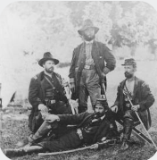
1864-1866
1864-1866: Most burials per year (4,092) total

Slide 4

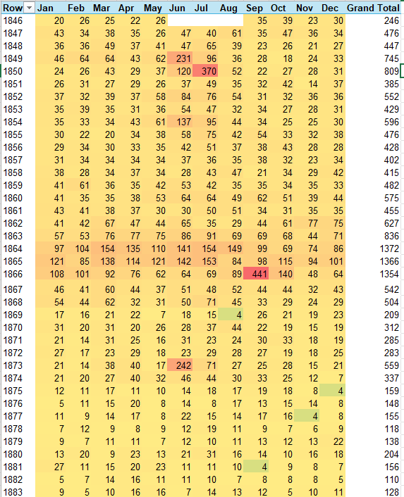
Burials per year by month
July 1850: Cholera Outbreak – 62% of Burials
September 1866: Cholera Outbreak – 74% of Burials
June 1873: Cholera Outbreak – 52% of burials
100% higher burial rate than control periods

Slide 5
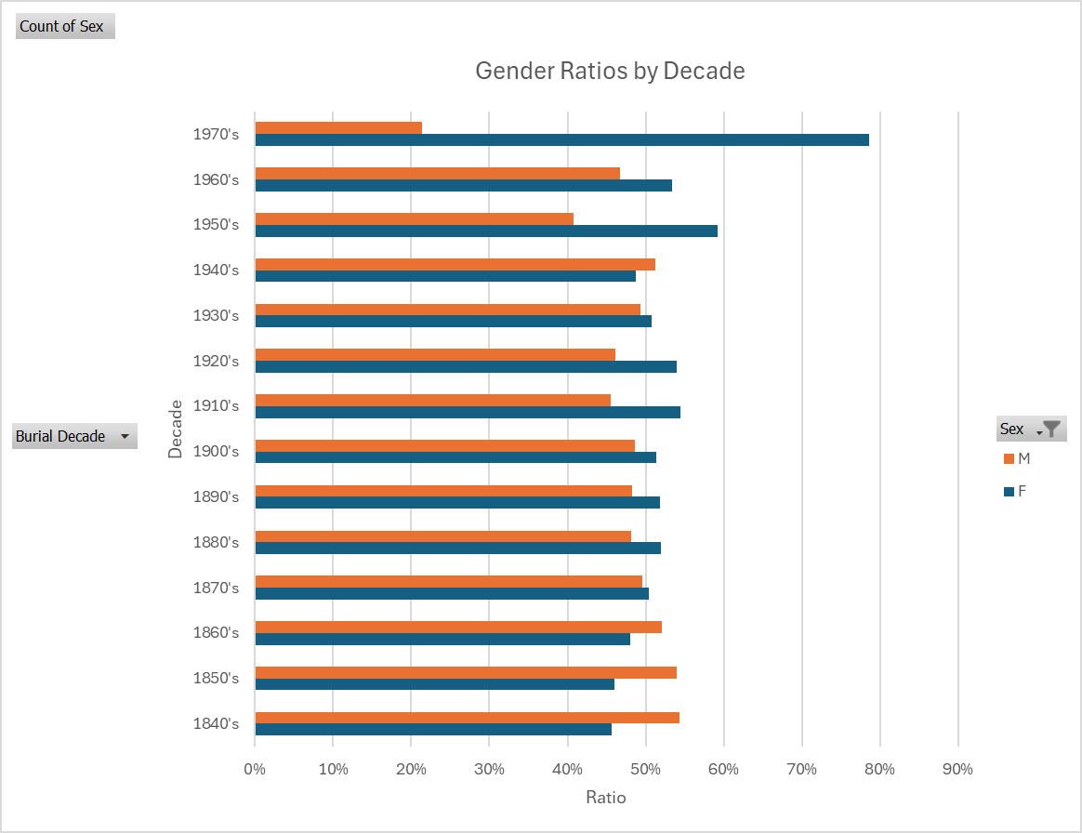
Engaging the audience
The percentage of female burials has increased with the decades.
1940’s: World War II
1970’s: Decreased burial activity
Techniques for connecting
Make eye contact with your audience to create a sense of intimacy and involvement
Weave relatable stories into your presentation using narratives that make your message memorable and impactful
Encourage questions and provide thoughtful responses to enhance audience participation
Use live polls or surveys to gather audience opinions, promoting engagement and making sure the audience feel involved

Slide 6
Selecting Visual Aids
Before 1880: Highest burial activity.
In all other time periods, 65+ counts for the largest portion of burials

Slide 7
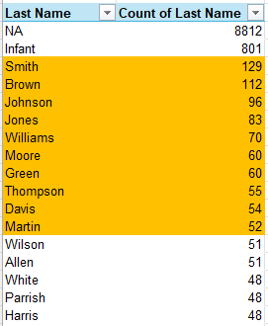
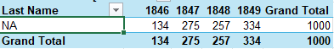
Top Ten Last Names
Burials with no Last Name
Any burials that with no last name occurred prior to 1850.

Slide 8
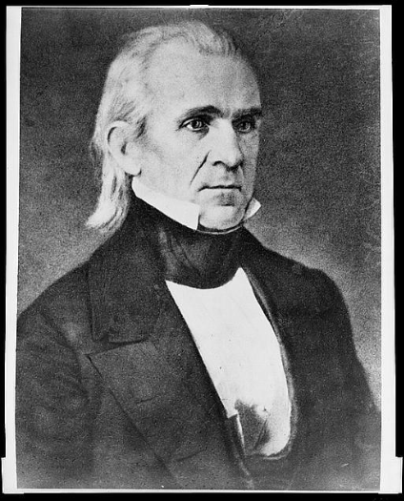
Person of interest?
James K. Polk
11th President of the United States.

Slide 9
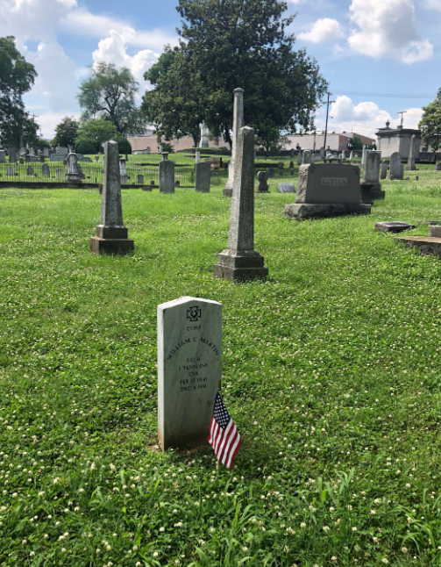
1864: A year of remembrance
Mean Age for Children buried: 9.5 years.
Mean age for Adults: 41.5 years.
Last infant Buried: Dec 29th, 1864.

Slide 10
Marketing takeaways
Historical significance
Nashville Landmark
Location and Scenery
Historical Tours
Guest Speakers or Authors
Honoring Veterans

Slide 11

Thank you

